Slide 1
2024.10.08
페이퍼로지 9 Black
페이퍼로지 5 Medium
^{페이퍼로지 3 Light}
페이퍼로지 5 Medium
1
Notes:
1

Slide 2
Blah BLah
Contents
2
Notes:
2

Slide 3
Introduction
TL;DR
Blah blah blah
Blah blah blah
Blah blah blah
Blah blah blah
3
Kumari, Nupur, et al. "Multi-concept customization of text-to-image diffusion." Proceedings of the IEEE/CVF Conference on Computer Vision and Pattern Recognition, 2023.
Notes:
3

Slide 4
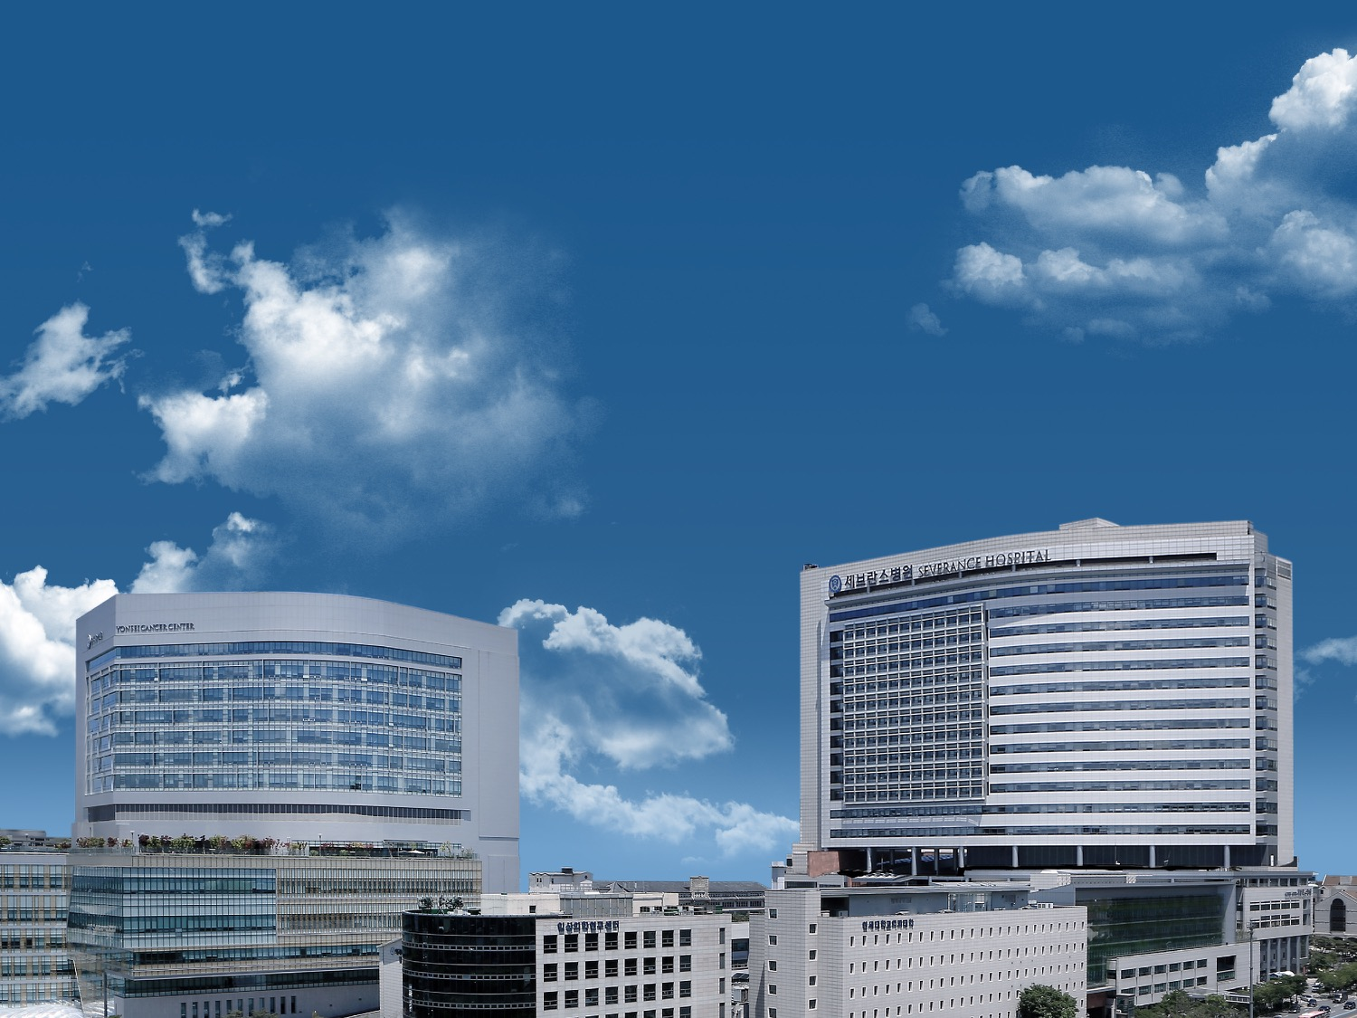
With the Love of God, Free Humankind from Disease and Suffering
감사합니다
Notes:
4

